Slide 1
2018 Medicare Web Application Training

Slide 2
Important Links
The production portals will be available as of 10/15/2018
SeniorCare (Cost) https://portal.swhp.org/Medicare/#/application?category=senior - Medicare SC
SeniorCare (Advantage) https://portal.swhp.org/Medicare/#/application?category=advantage - Medicare Advantage
Vital Traditions https://portal.swhp.org/Medicare/#/application?category=vital - Medicare Vital

Slide 3
Introducing...
Notes:
Disclaimer: This presentation captures SeniorCare (Cost) screenshots: however, the screens apply to all portals-- SeniorCare Cost, SeniorCare Advantage, and Vital Traditions. Slight differences may appear.

Slide 4
New for 2018!
SeniorCare Advantage Application Portal
SeniorCare (Cost): Electronic Funds Transfer (EFT) is a CMS-approved option.
SSI Deduction Message
Functionality to upload supporting documentation
Printable application copy
Updated Customer Service and Sales Support phone numbers
SeniorCare (Cost): Limited Enrollment Criteria
Notes:
SeniorCare Advantage application portal displays all plans available in the enrollee’s county of record.
SeniorCare (Cost) premiums may now be paid through automatic deduction when the enrollee selects EFT.
SSI deduction can take up to 60 days; a message now displays on the web application portal.
Supporting documentation (i.e., new Medicare card, transplant documentation for ESRD, etc.) may now be uploaded as part of the application process. The documents will be stamped with the application confirmation number for our internal teams to process along with the application.
Printable copies of the completed application are now available. Select print and a PDF will display.
Customer Service and Sales Support phone numbers have been updated throughout the web application.
SeniorCare (Cost) will sunset. In the last year of the plan (2018), CMS limits enrollment to specific criteria. On 12/8, the web application logic will display to ensure enrollees met the CMS criteria.

Slide 5
SeniorCare Advantage Web Portal – County
Notes:
Select the enrollee’s county of record.

Slide 6
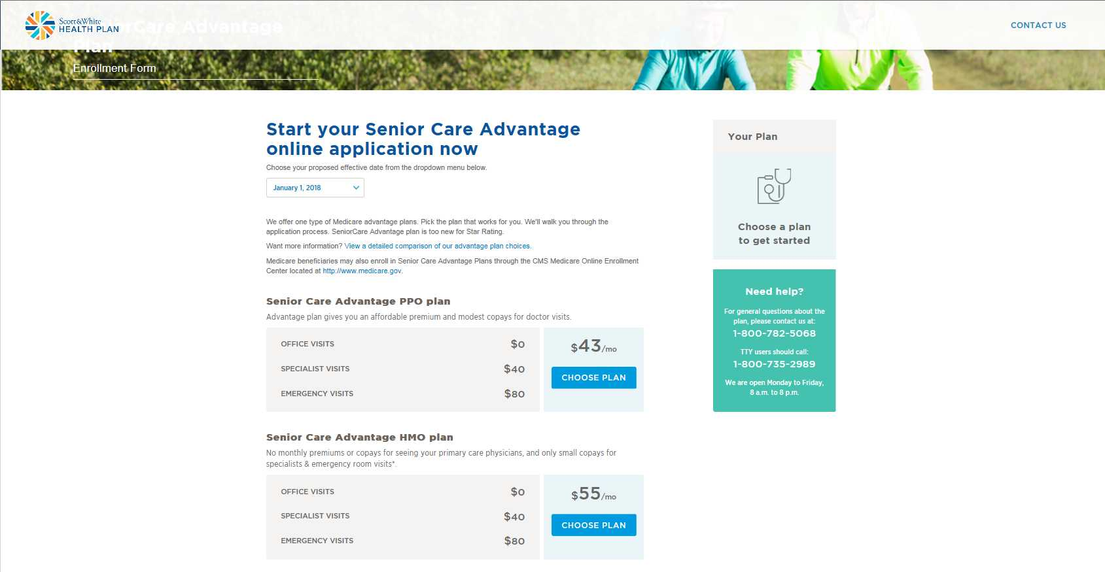
Senior Care Advantage Web Portal - Plan
Notes:
Available plan options will display.

Slide 7
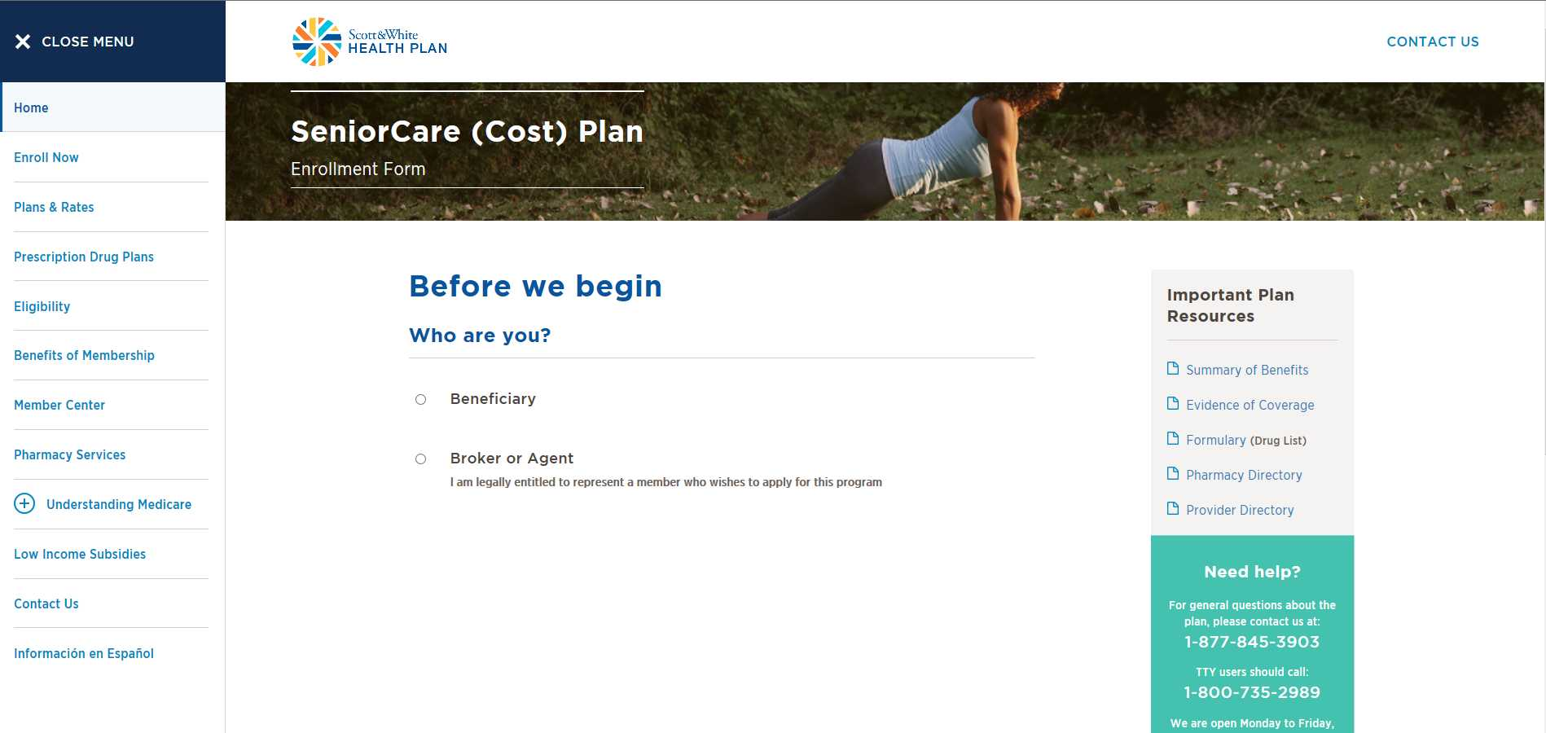
Basic Navigation
Notes:
Welcome to the Home screen! Agents/brokers and enrollees will use the portal to submit an enrollment for Senior Care and Vital Traditions. The Senior Care website has been used to create this training document. Both websites navigate exactly the same, with slight visual differences.

Slide 8
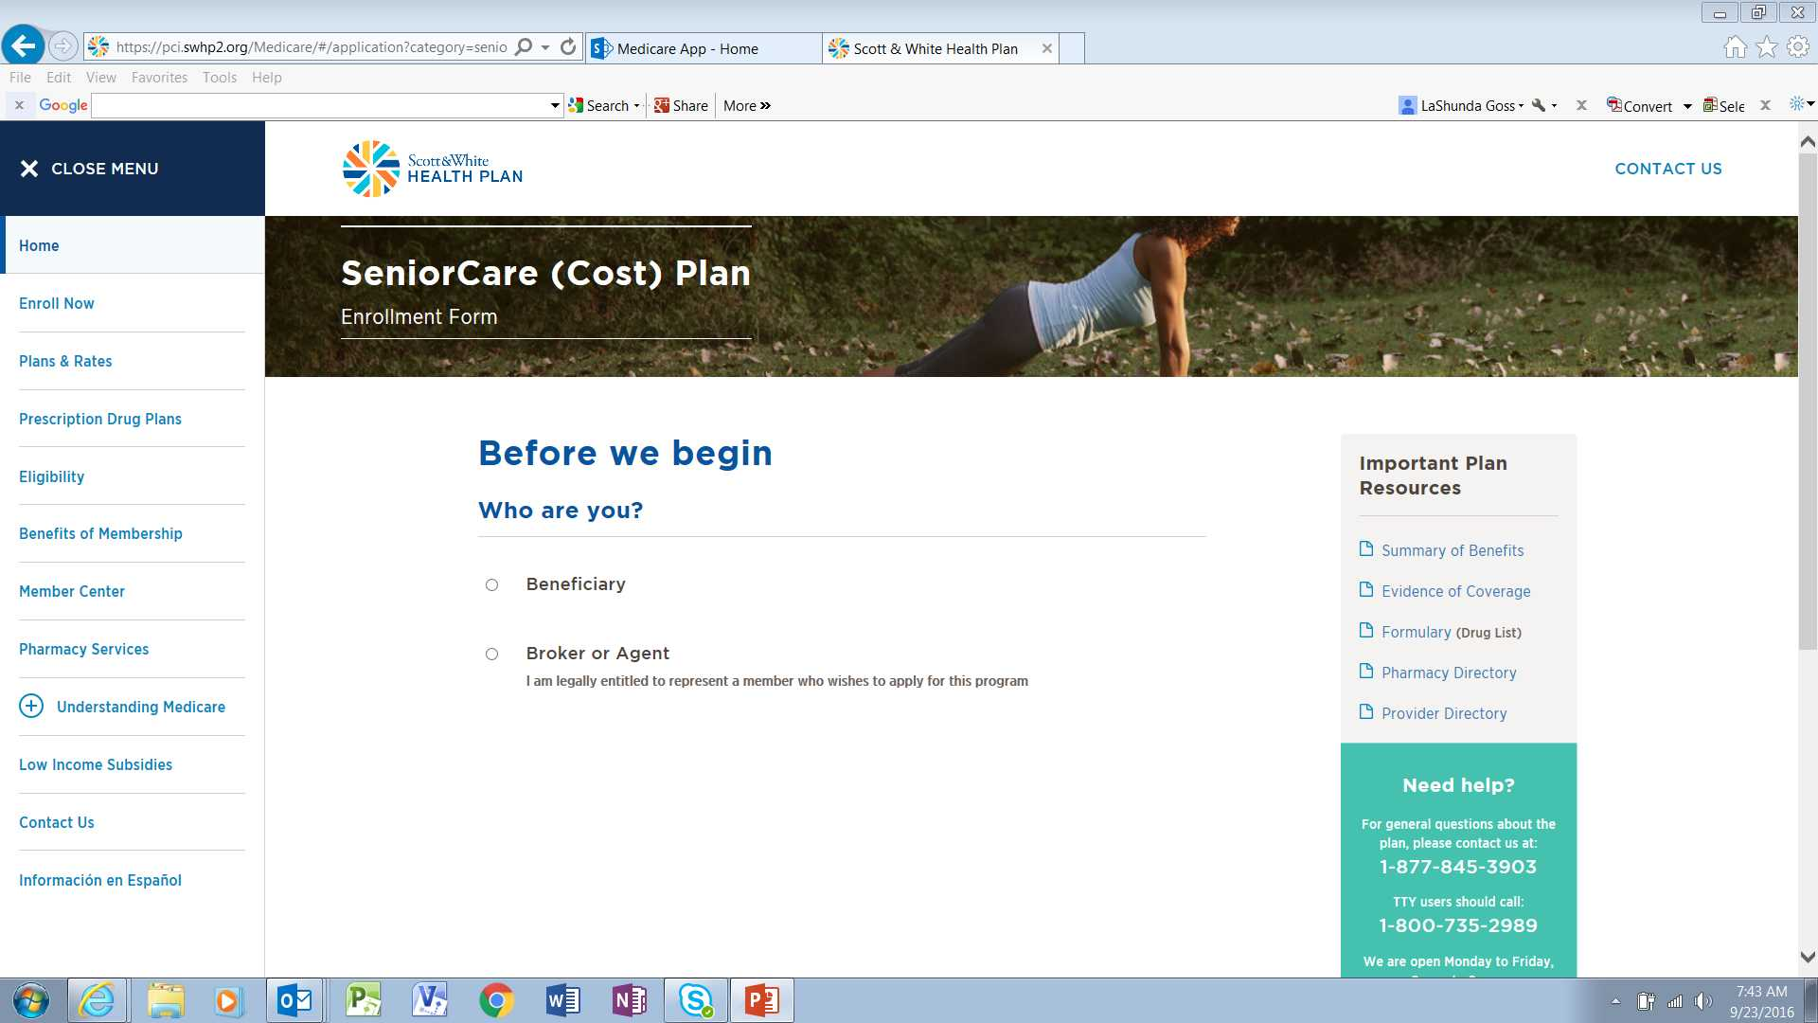
Before We Begin
1.
Notes:
Select Broker/ Agent

Slide 9
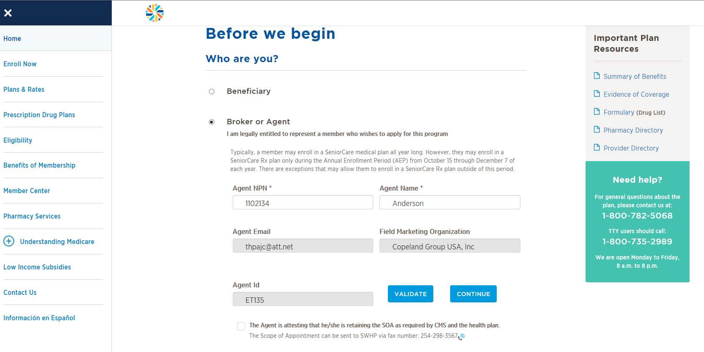
Before We Begin Agent/Broker Validation
2.
3.
Notes:
Enter your NPN – writing number is not acceptable
Enter last name
Select Validate
Any field marked with an asterisk (*) is a required field. If left blank, you will not be able to move to the next step. Currently, the tool does not display the missing field.

Slide 10
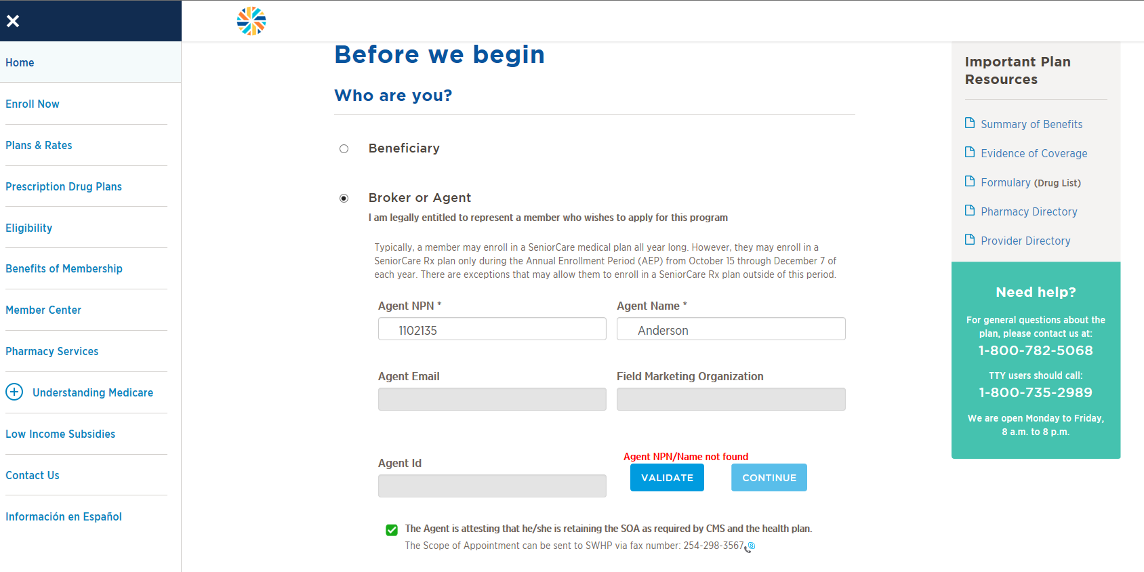
Before We Begin Incorrect or Invalid NPN
Notes:
If the agent/broker enters the incorrect information, or the agent/broker is not on the “ready to sell” feed from Calidus, the agent/broker will receive an error message and will not be able to continue with the application. The agent/broker will need to contact agent support for more details.

Slide 11
Before We Begin
5.
4.
Notes:
Once the NPN has been validated, the agent/broker will need to check the box attesting to the scope of appointment message, if applicable.
Select continue.

Slide 12
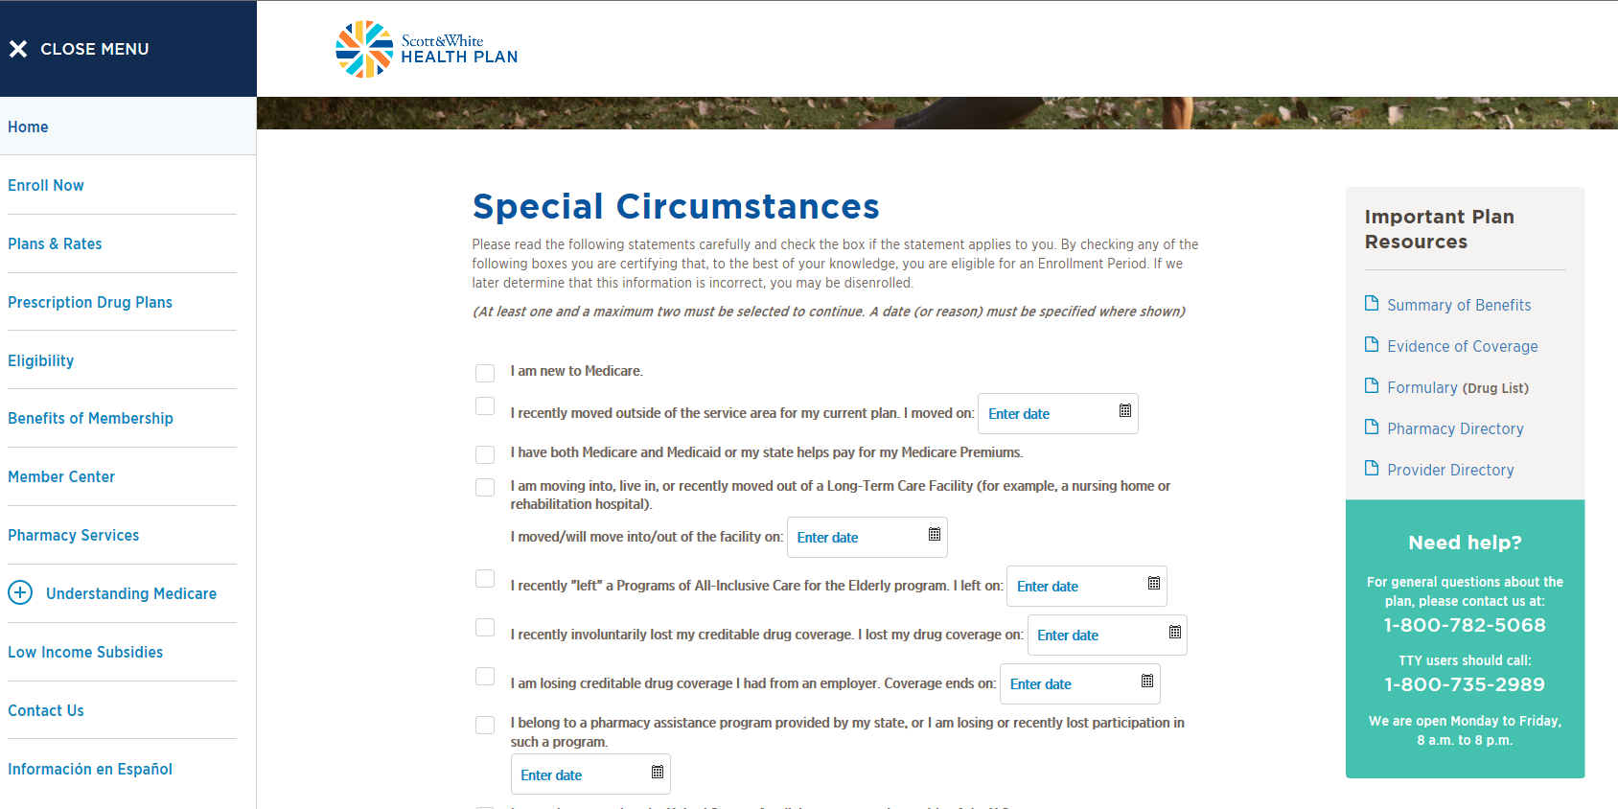
Special Circumstances
6.
7.
Notes:
If applicable, select a special circumstance. If a date is displayed, this is a required field.
Otherwise proceed to “skip to AEP”
Select ‘Begin Application’
During AEP, you will be able to skip the special circumstances section and move directly into the application entry.

Slide 13
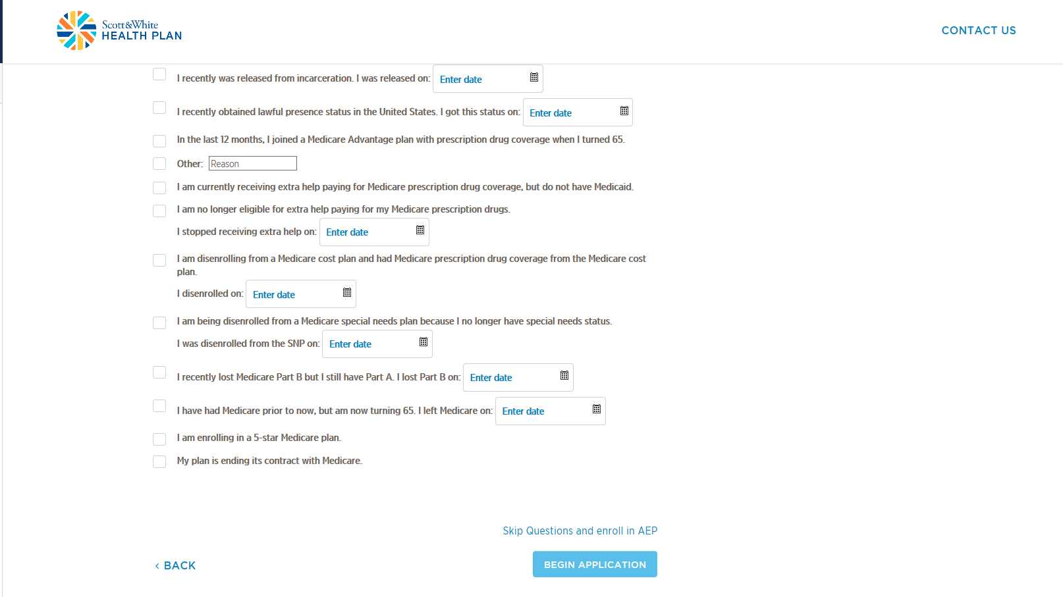

Slide 14
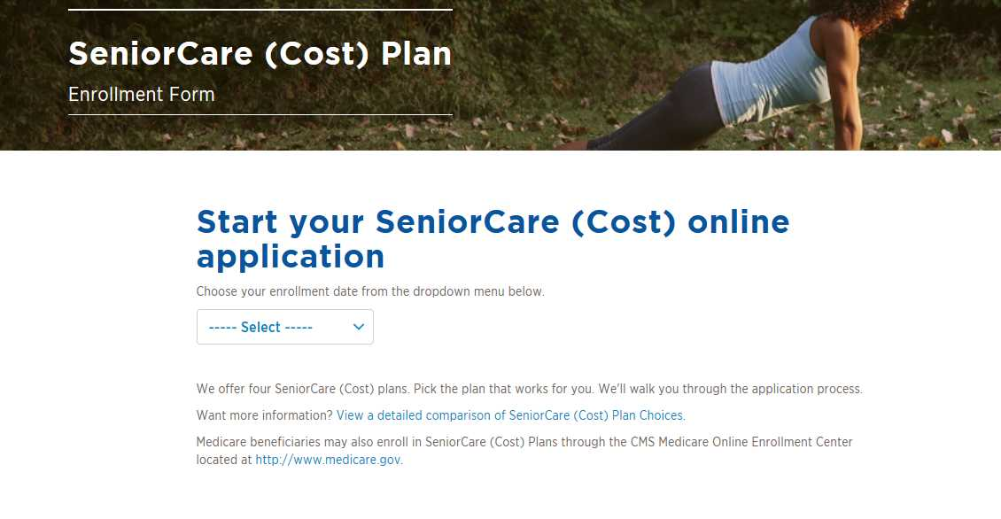
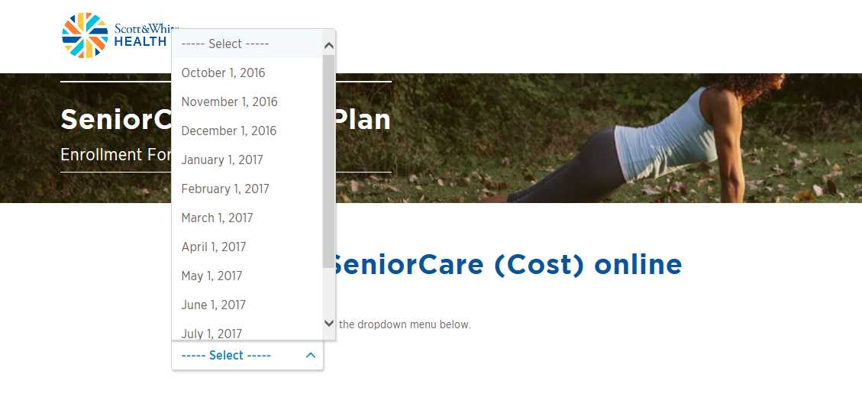
Effective Date
8.
Notes:
Select the effective date
If the agent/broker skips directly to AEP, only 1/1/2017 will appear in the drop down.

Slide 15
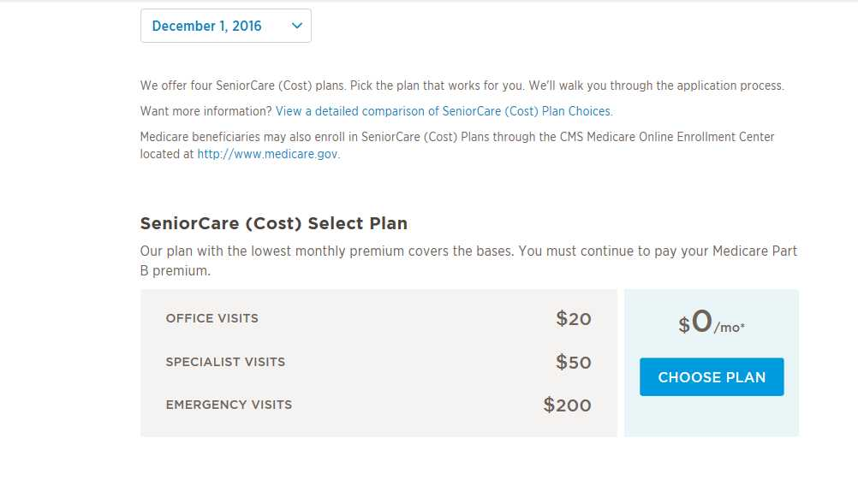
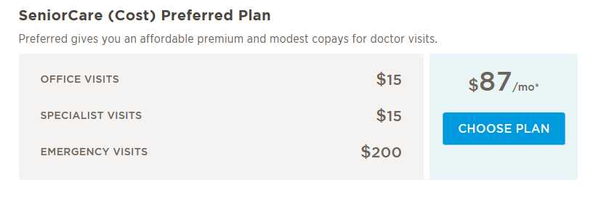
Plan Selection
9.
Notes:
Select the medical coverage

Slide 16
Plan Selection
Notes:
If applicable, add prescription coverage.

Slide 17
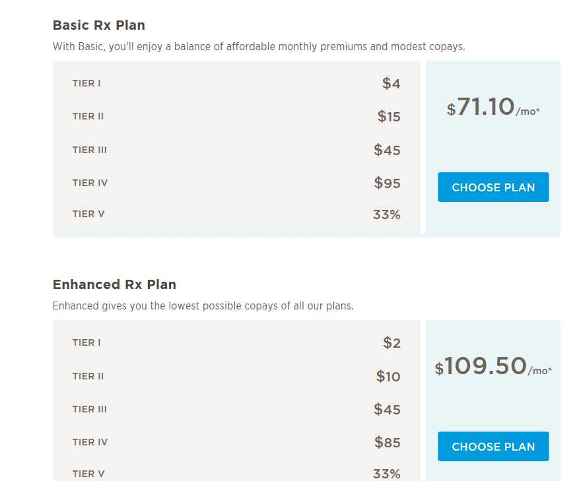
Plan Selection
10.

Slide 18
Plan Selection – Rx
Notes:
Rx coverage may be declined. A warning message will appear, select continue.

Slide 19
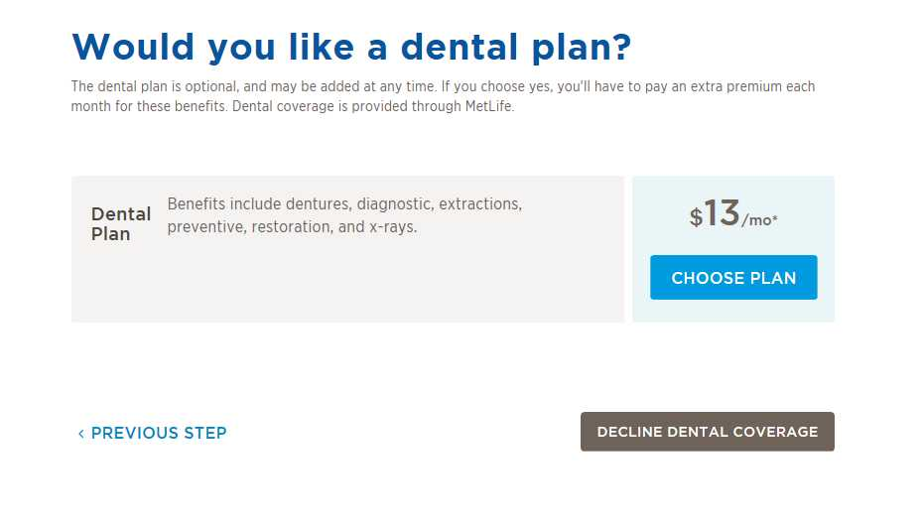
Plan Selection – Dental
11.
Notes:
Select or decline dental

Slide 20
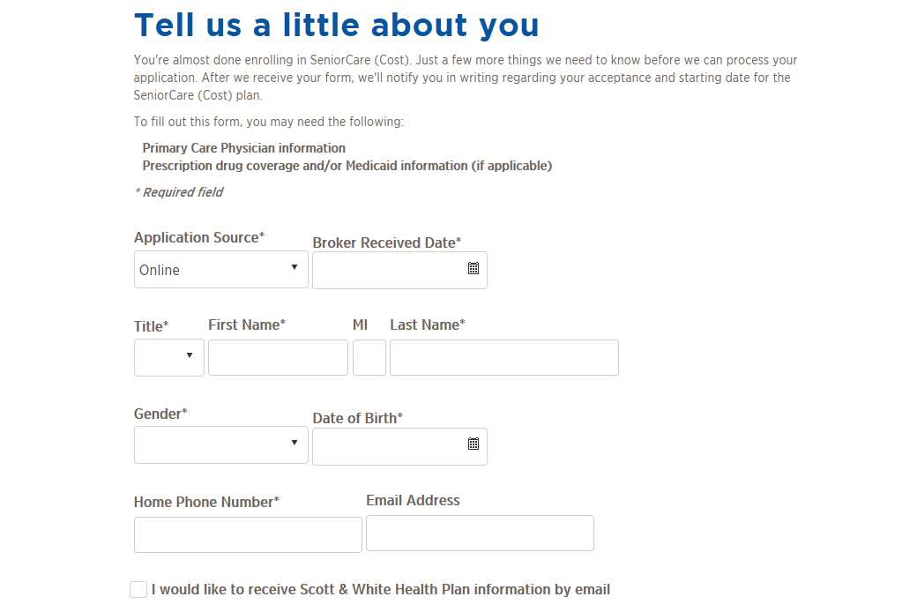
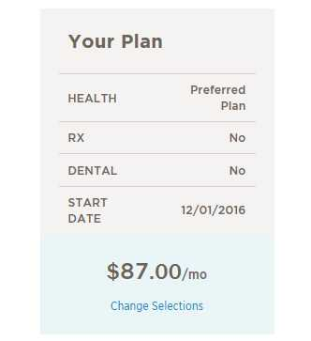
Application Details
12.
Plan selection details remain on the screen throughout the process
Notes:
Next you will be asked to enter the member information.
Select the application source (online/telephonic).
If the application is taken on paper, you must submit the paper application.
The plan selection will continue to display as you proceed through the application.
If an email address is entered, the member will receive a confirmation once the application has been submitted.

Slide 21
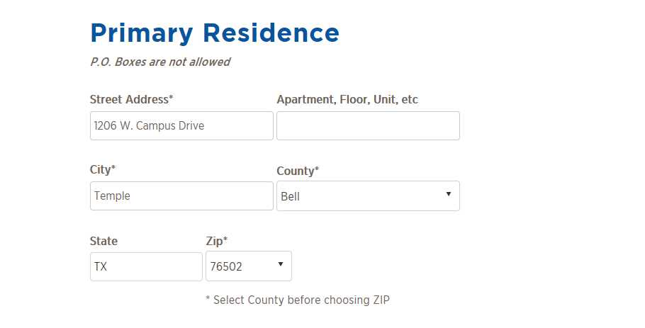
Application Details – Permanent Address
13.
Notes:
Enter the member’s complete address. The county must be selected before the ZIP can be entered.
PO Boxes are not allowed. If a PO Box is entered, you will not be able to move to the next step in the application process.

Slide 22
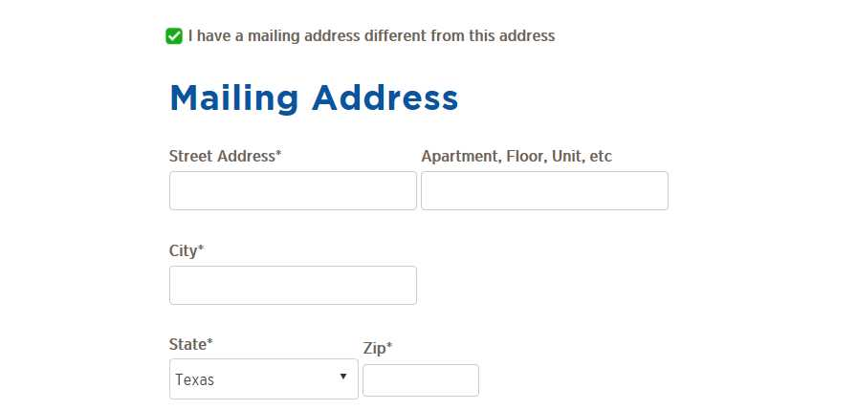
Application Details – Mailing Address
Notes:
A mailing address can be added.
Check “I have a mailing address different from this address.” Address fields will be displayed for the address to be entered.
Add the mailing address

Slide 23
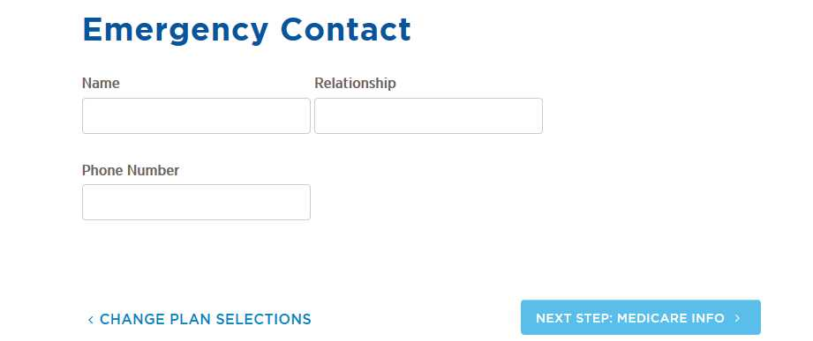
Application Details – Emergency Contact

Slide 24
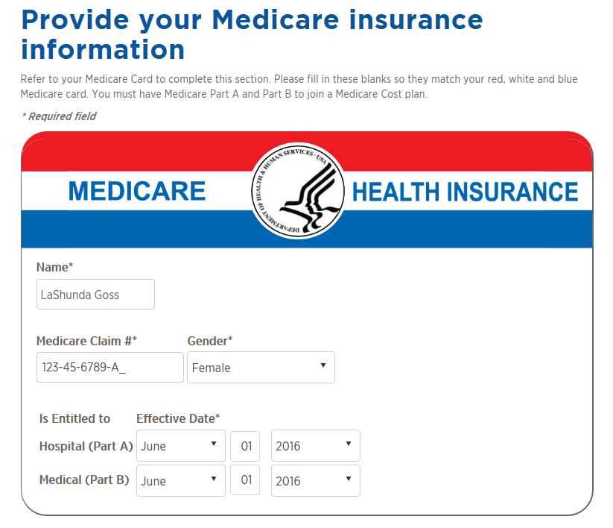
Application Details – Medicare Info
14.

Slide 25
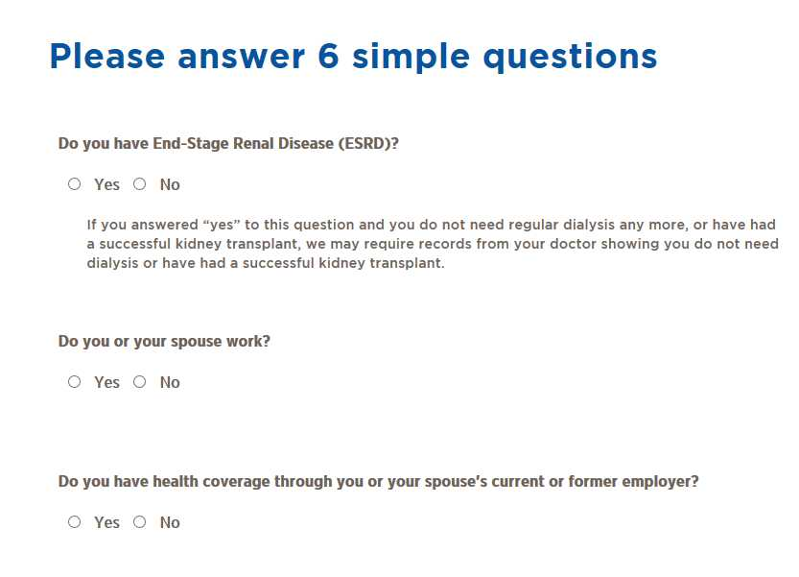
Application Details – Medicare Questions
15.
Notes:
Each question will need to be completed before proceeding to the next step.

Slide 26
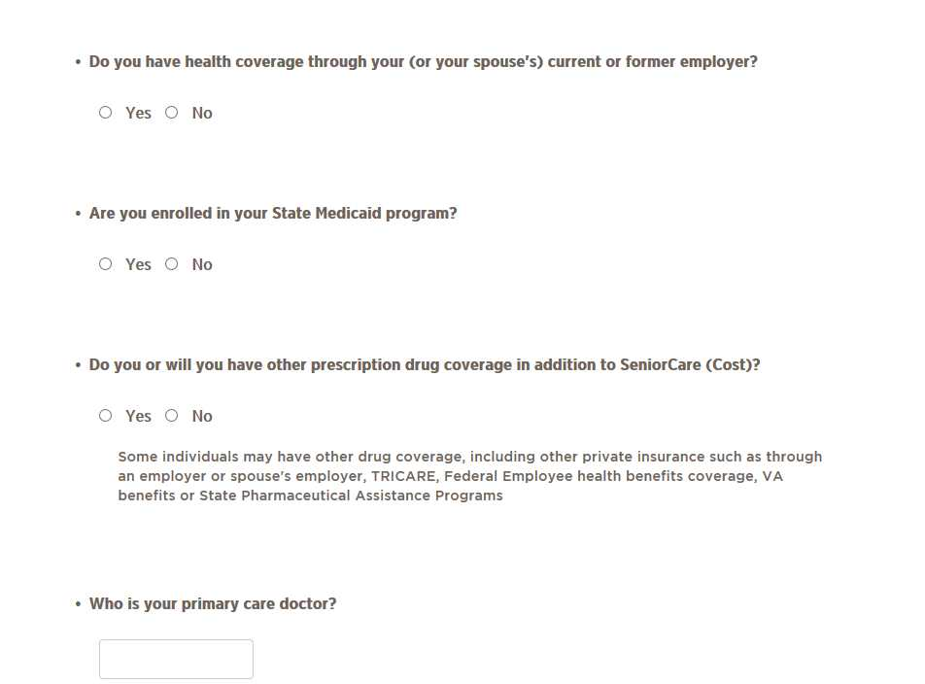
Application Details – Medicare Questions
Notes:
Each question will need to be completed before proceeding to the next step.

Slide 27
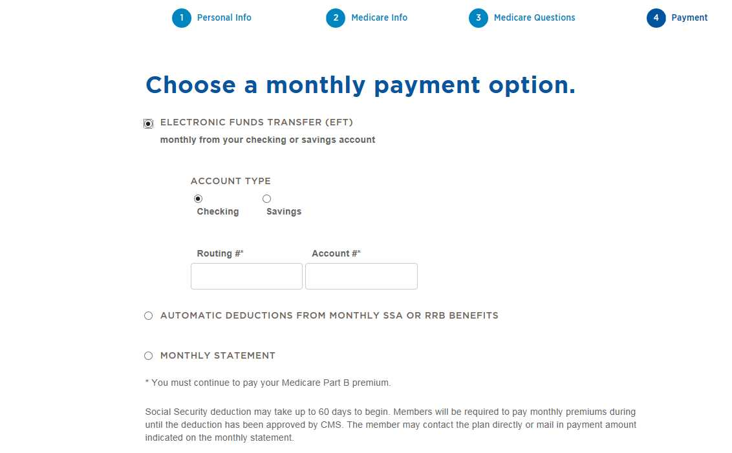
Application Details – Payment Option
NEW!
NEW!
Notes:
Select payment option = Electronic Funds Transfer (EFT) and a drop down will appear to enter banking information (routing/account), the information will be secured and processed with the enrollee’s application.
SSA deduction can take up to 60 days; a message now displays, informing agents/brokers/enrollees that payment will be due until SSA has accepted the transaction.
Proceed to the next step

Slide 28
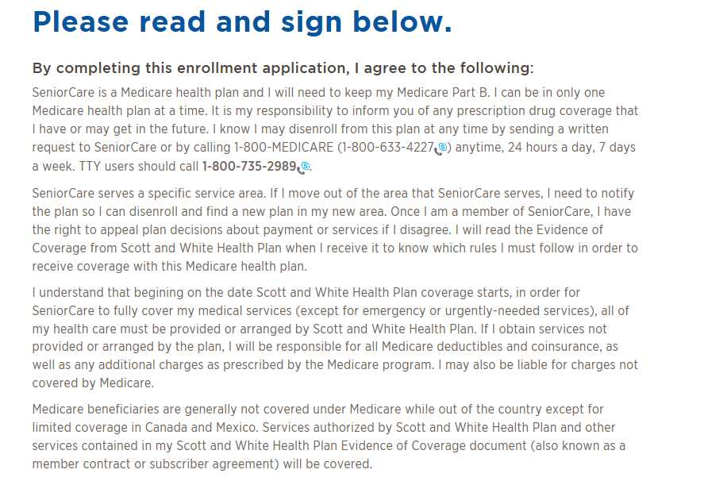
Application Details- Disclosures
Notes:
Next, the disclosure statement will display.

Slide 29
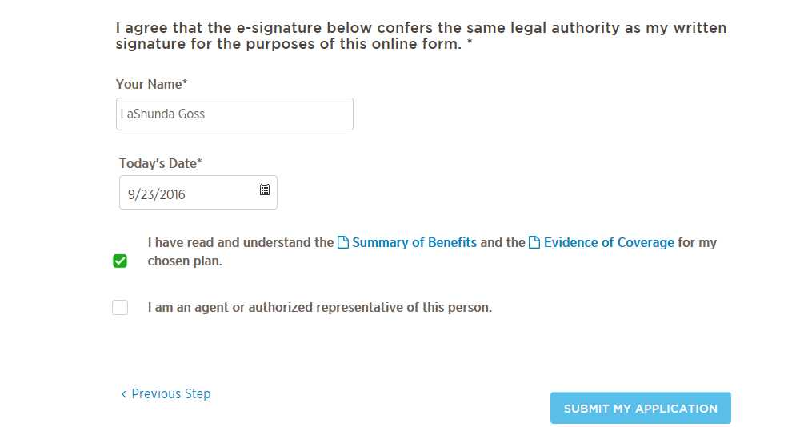
Application Details – Electronic Signature
17.
18.
Notes:
Enter the member name
Enter the current date
Select the “I read and understand the Summary of Benefits and the Evidence of Coverage for my chosen plan.”
If someone acting on the member’s behalf (i.e., Power of attorney)
Select the ‘I am an agent or authorized rep of this person’; otherwise leave the box blank.
Agent/broker information should not be entered in this section. The agent/broker information is attached to the application based on the validate NPN entered at the start of the application.
Select submit application

Slide 30
Application Details – Electronic Confirmation
19.
Notes:
The electronic confirmation will display.
Select ‘OK’

Slide 31
Application Details – Upload: Supporting Documents
NEW!
Notes:
As of 2017, you can upload supporting documentation to support special circumstance or other documentation necessary to complete the application such as: proof of kidney transplant, Medicare card if new to Medicare, etc.
If supporting documents are not required, select “No Documents to upload.”

Slide 32
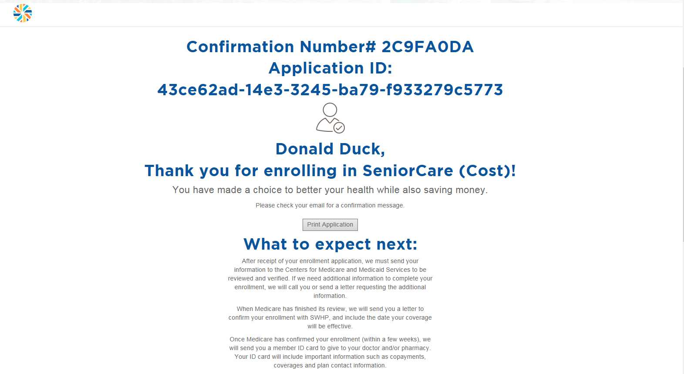
Confirmation – Printable App Copy
NEW!
Notes:
The confirmation number will be the mechanism to track the application through the process. For 2018 applications, select print and a copy of the application will be available to print (refer to next slide).

Slide 33
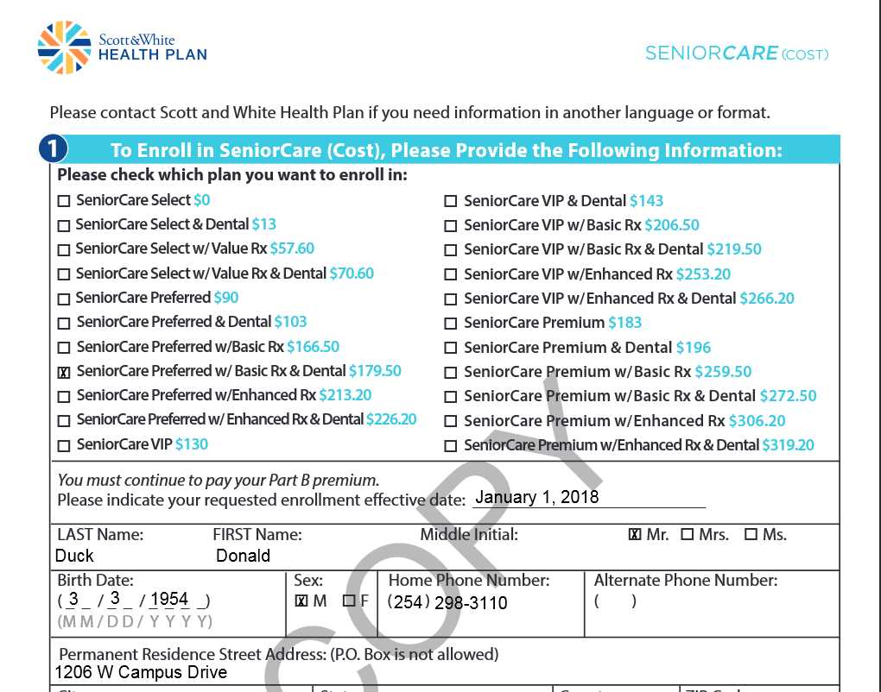
Confirmation – PDF
NEW!

Slide 34
NEW!
Customer Service: 866-334-3141
Notes:
The next section explains the steps in the application process.
Once the application has been submitted, allow 24 hours for the app to update our systems.
The application will be submitted to Medicare. If additional information is required, we will reach out to the member to complete the application process.
Medicare will confirm the application and send us back confirmation.
We will update the membership system and send a confirmation letter and ID card out to the member.
New customer service number for 2018 is 866-334-3141.

Slide 35
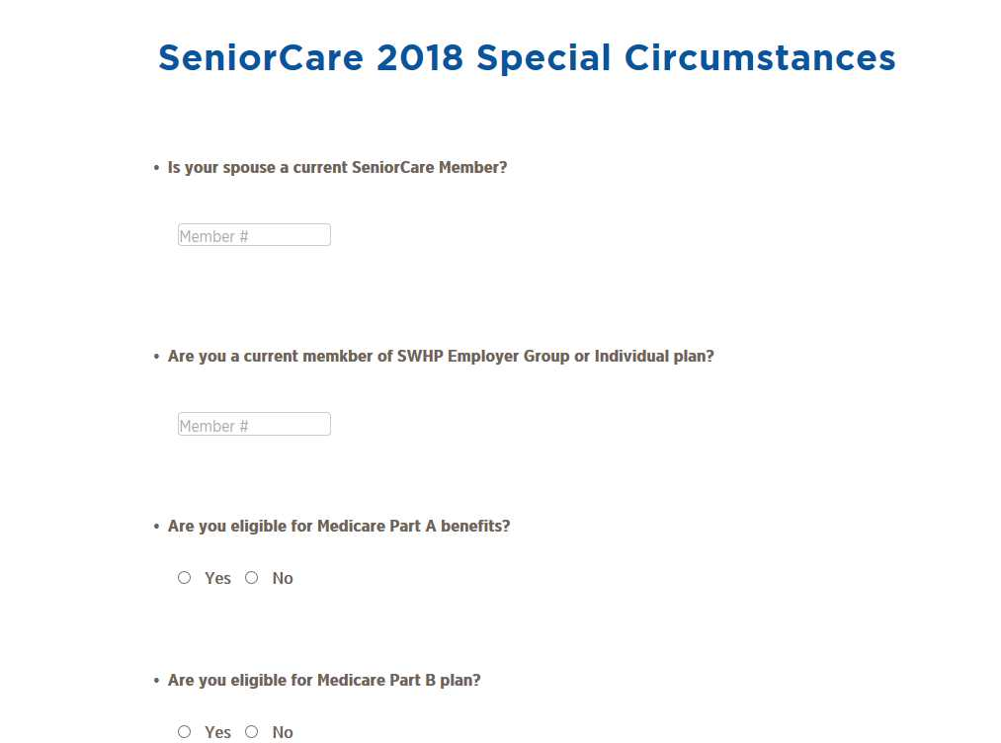
Post AEP (12/8) – Special Circumstances
NEW!
Notes:
The Cost plan contract with Medicare will end December 31, 2018. With this closure, CMS requires plans to limit enrollment and enrollees must meet the following special circumstances:
1. Accepted from spouses of current SeniorCare members.
2. Accepted from individuals who are currently covered by a Scott and White Health Plan or Insurance Company of Scott and White employer group health plan, and elects to enroll into SeniorCare on or after application date = 12/08/2017, for an effective date of 1/1/2018 or later.
3. Accepted from individuals who age in (turn/will turn 65) or become entitled to Part A benefits, or were enrolled under Part B, and were enrolled in a plan in an individual or other plan with SWHP or Insurance Company of Scott and White (ICSW).
This page will display and must be completed prior to completing the enrollment application. Enrollees will not be able to initiate an application, and must contact an agent to enroll.

Slide 36
Appendix

Slide 37
Application Entry – Instructions
Navigate to the portal links
Select ‘Broker’
Enter Agent/Broker NPN
Enter Agent/Broker Name
Select Validate
Attest to Scope of Appointment question
Select Continue
If applicable, select at least one Special Circumstance, otherwise skip to AEP

Slide 38
Application Entry –Instructions
Select Begin Application
Select Effective Date
Select Plan Benefits
Enter Member demographics
Enter Medicare information directly from the Medicare Card
Answer the Medicare Questions
Select Payment Method
Enter the enrollees name and today’s date

Slide 39
Application Entry – Instructions
Place a checkmark in the Summary of Benefits box
If the member has an authorized representative (power of attorney or other) check the “I am an agent or authorized rep box” and fill-in the fields
Select “Submit Application”
Select “OK” to confirm intent to proceed with online enrollment
Document the Confirmation number for future application status tracking

Slide 40
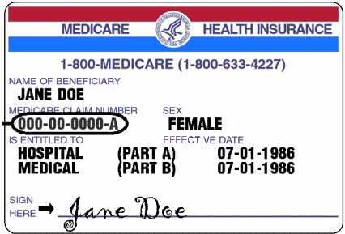
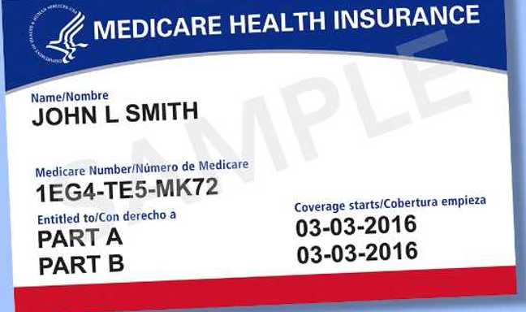
Medicare Card
Current Medicare Card
New! Medicare Card 2018
Notes:
CMS will start mailing new Medicare cards in 2018. Beneficiaries will be issued a unique “MBI” Medicare Beneficiary Identifier that will replace the Medicare Claim number or HICN. CMS will allow a transition period from April 2018 – December 2018, after all transactions MUST use the MBI.

Slide 41
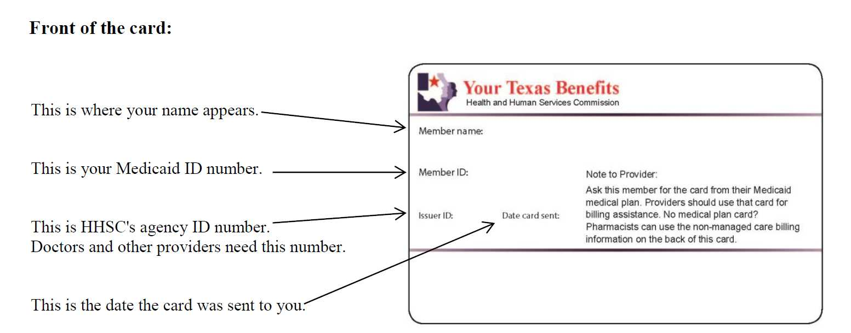
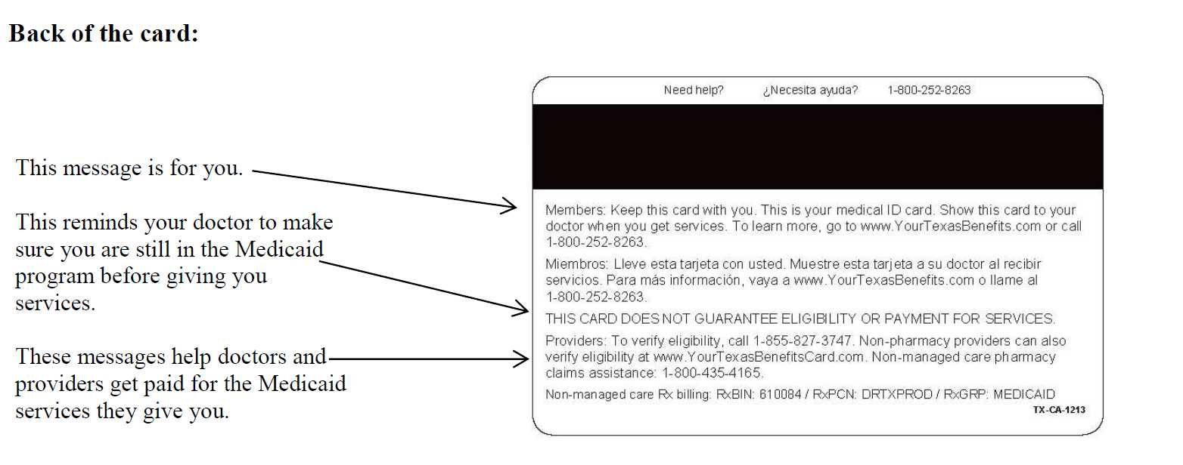
Medicaid Card

Slide 42
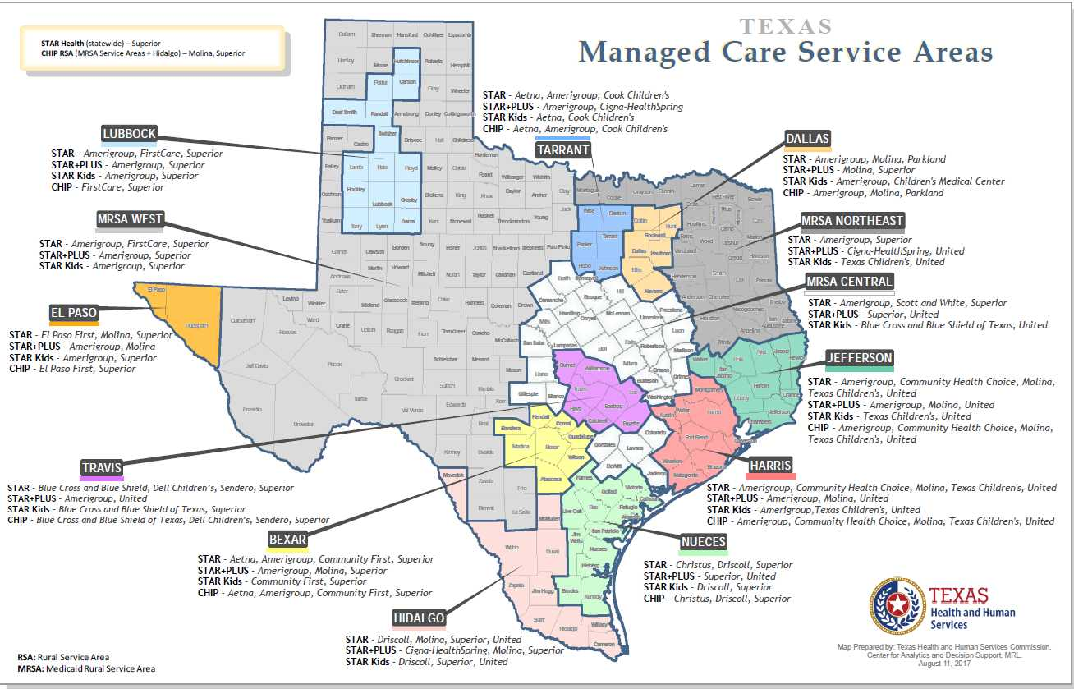
Medicaid – Managed Care
Notes:
Beneficiaries may also be covered by a Medicaid HMO.

